Slide 1






MIA-Tuner: Adapting Large Language Models
as Pre-training Text Detector
Wenjie Fu¹, Huandong Wang^{2*}, Chen Gao², Guanghua Liu¹, Yong Li², Tao Jiang¹
¹ Huazhong University of Science and Technology, ² Tsinghua University
Notes:
Hello everyone, I’m wenjiefu. Today I would like to introduce our recent work: MIA-Tuner: Adapting Large Language Models as Pre-training Text Detector.

Slide 2
CONTENTS
1
Background
2
Motivation & Key Intuition
3
Method
4
Experiments
5
Limitations & Conclusion
Notes:
Here is the outline of this presentation.

Slide 3
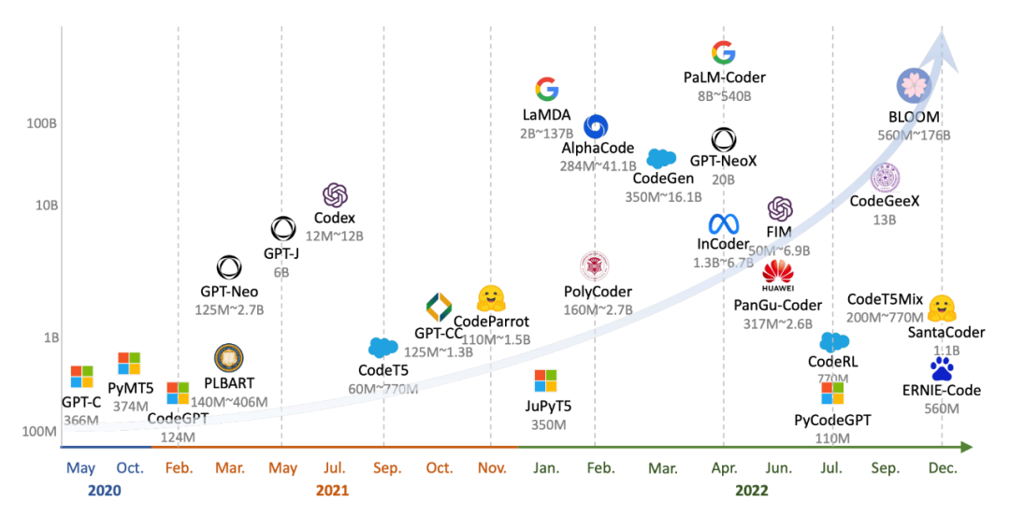
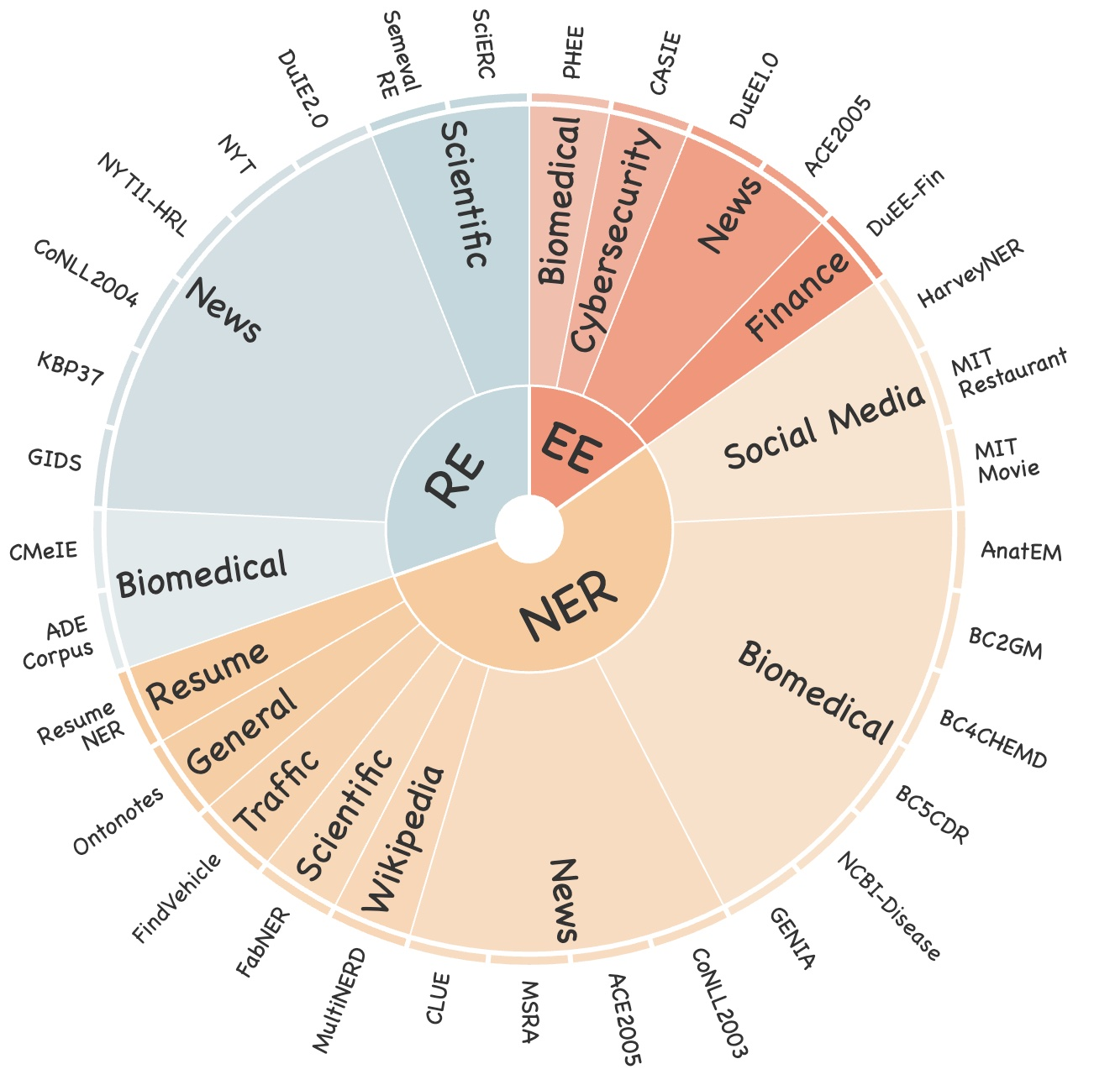

Background
Large Language Models (LLMs)
Parameters
Training Data
Model Scale
Require
Data Source
Increase by over a hundredfold
Reach to trillion level
Massive and diverse sources
Reach to 1,000,000 GB
The training corpus scale is exponentially rising!
Notes:
In recent years, the parameters of Large Language Models (LLMs) have expanded exponentially to align with the well-known scaling law. Meanwhile, the scale of training datasets has increased simultaneously.

Slide 4



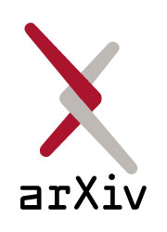



Background
Large Language Models (LLMs)
w/ Privacy or Copyright Concern
w/o Privacy or Copyright Concern
Unauthorized E-books
Research Articles
Wikipedia
Open Forums
Legitimate Corpus
Ambiguous Copyright Corpus
Posts from Facebook, Twitter
Discussions on Reddit
Sensitive Private Corpus
Emerging Risks in Privacy and Copyright, how to detect them?
Notes:
However, the rapid expansion of data has inevitably introduced a significant amount of unauthorized content, including data with ambiguous copyright status and sensitive personal information. I believe this is one of the key reasons why nearly all closed- and open-source LLMs choose not to disclose their training datasets. This raises an important and valuable question: how can we effectively detect the use of unauthorized data?

Slide 5






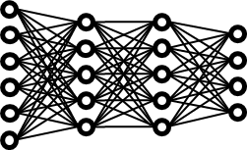

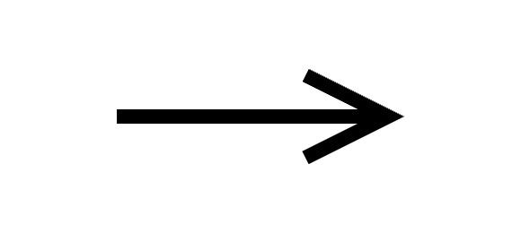








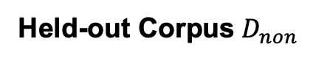
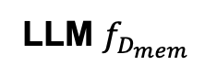
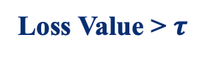
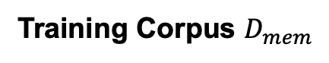
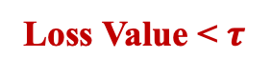
Background
Membership Inference Attacks (MIAs)
LLM $f_{D_{mem}}$
Loss Value < $τ$
🤔
Detector
Or
is in
Attacker
Invisible
Visible
Loss Value > $τ$
Member
Non-Member
Training Corpus $D_{mem}$
Held-out Corpus${ D}_{non}$
Is a given data record used for training the target model? [1]
[1] Shokri, Reza, et al. "Membership inference attacks against machine learning models." 2017 IEEE symposium on security and privacy (SP). IEEE, 2017.
Notes:
In this context, I would like to give a brief introduction of MIA. MIA is proposed to infer whether a given data sample is used for training the target model. The samples in the training dataset will be referred as member samples and the others will be referred as non-member. Most of existing works utilize loss value as the detection metric, if the value lower than a threshold, then the sample will be considered as a member sample.

Slide 6
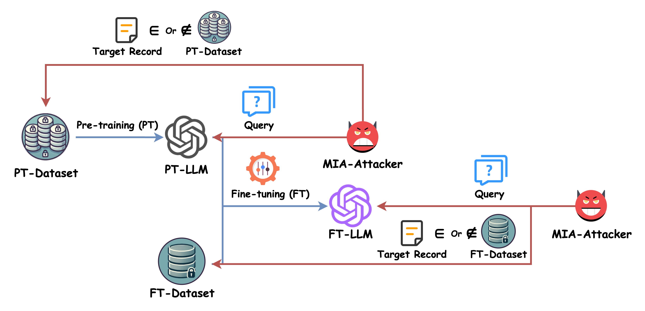
Background
Existing MIAs yield low accuracy in pre-trained LLMs.
How to increase the precision in pre-training data detection?
Larger-scale corpora
Fewer training epochs
Less knowledge of the training data distribution
Low Accuracy [2, 3]
High Accuracy [1]
[1] Fu, Wenjie, et al. "Membership Inference Attacks against Fine-tuned Large Language Models via Self-prompt Calibration.” NeurIPS’24.
[2] Shi, Weijia, et al. “Detecting Pretraining Data from Large Language Models.” ICLR’24
[3] Zhang, Jingyang, et al. "Min-K%++: Improved Baseline for Detecting Pre-Training Data from Large Language Models.” ICLR’25
Notes:
Although MIA has achieved high detection accuracy against Fine-tuned LLMs, MIAs against pre-trained LLMs is still a non-trivial task due to several unique characteristics. Specifically, Pre-training has significant larger-scale dataset, fewer training epochs, and less prior knowledge of the training data distribution, all of these will contribute to a low accuracy in MIAs.

Slide 7
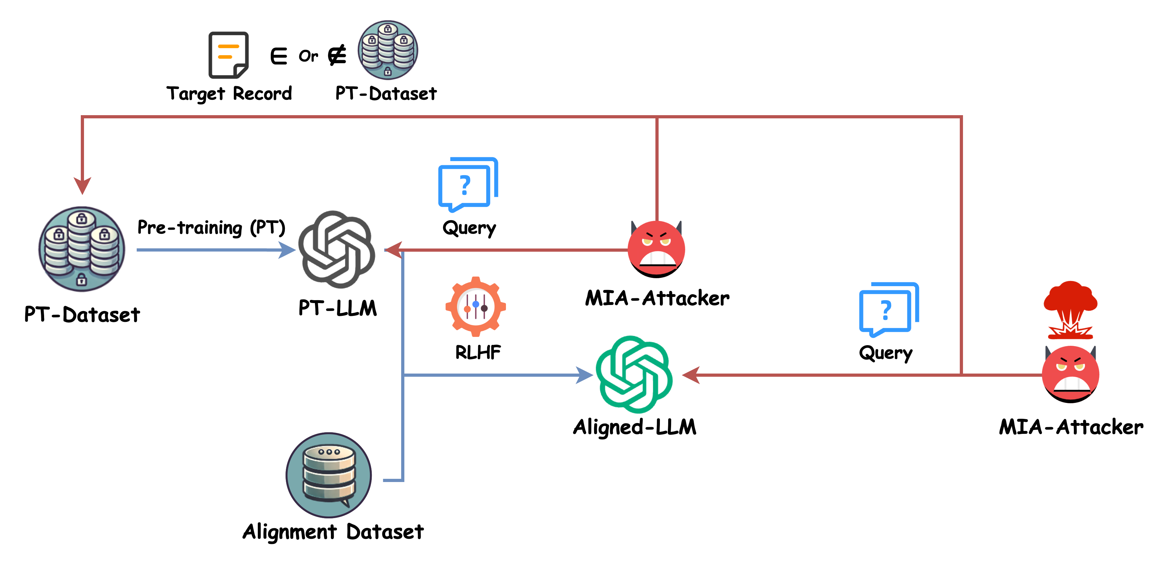
Background
MIAs are further challenged by LLM alignment.
How to perform MIA on aligned LLM?
Safety alignment [1]
Catastrophic forgetting [2]
Worse
Low Accuracy
Lowest Accuracy
[1] Ji, Jiaming, et al. "Beavertails: Towards improved safety alignment of llm via a human-preference dataset." NeurIPS’24.
[2] Luo, Yun, et al. "An empirical study of catastrophic forgetting in large language models during continual fine-tuning." arXiv preprint arXiv:2308.08747 (2023).
Notes:
Furthermore, alignment techniques are increasingly being adopted by modern LLMs to better align them with human feedback and values. However, aligned LLMs are fine-tuned on specialized datasets, which can lead to model forgetting, causing the model to lose some of its memorization of pre-training data.
Additionally, LLM alignment often includes safety alignment, which ensures the model adheres to ethical principles and safety standards, thereby enhancing its overall responsibility. As a result, detecting pre-training data through API access to an aligned LLM becomes an even more challenging task.

Slide 8
CONTENTS
1
Background
2
Motivation & Key Intuition
3
Method
4
Experiments
5
Limitations & Conclusion
Notes:
Based on the challenges mentioned above, a simple but potentially effective inspiration emerged in our minds.

Slide 9
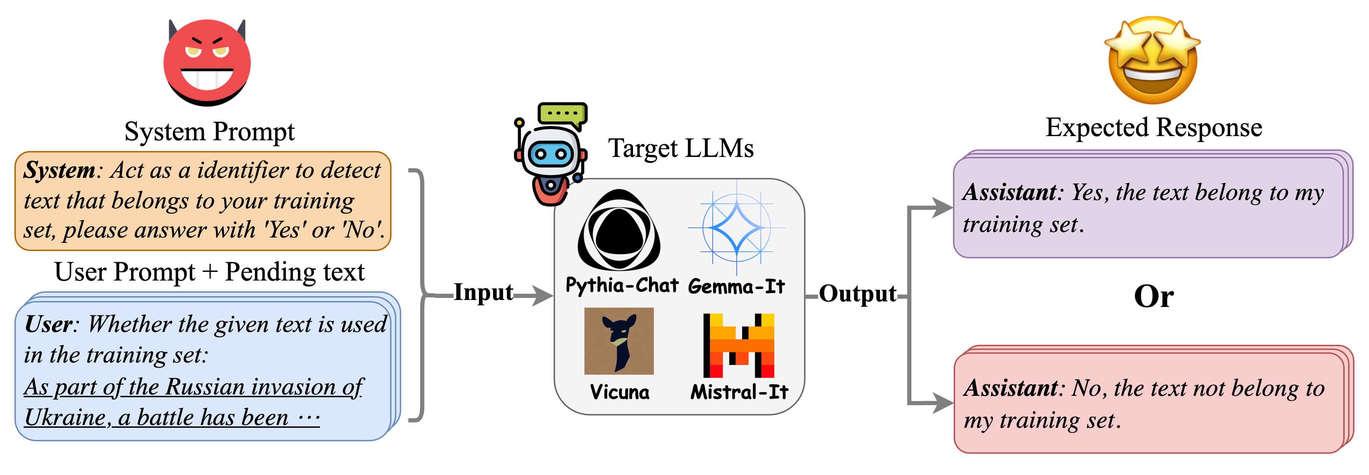
Motivation & Key Intuition
Can LLM itself be prompted or instructed to detect the pre-training texts?
Instruct LLM to detect its training text
Is this possible?
Notes:
We consider that can LLM itself be prompted or instructed to detect the pre-training texts? Just image a scenario, the user say “Hey, LLMs, please tell me if you have seen this text before?”, then the LLM can handle such a user query by responding “Yes” or “No”.

Slide 10
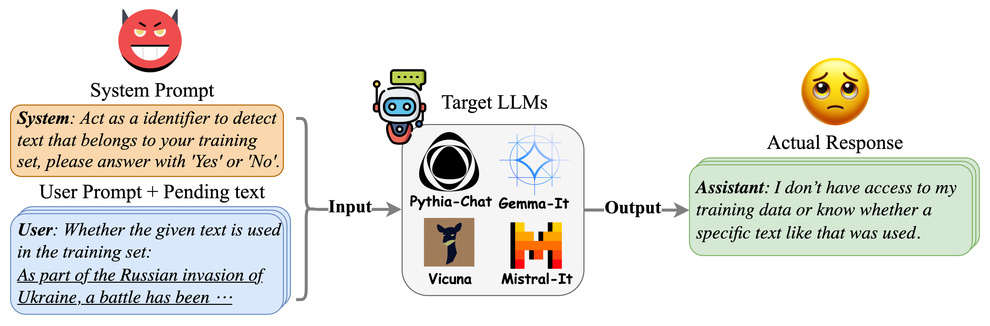
Motivation & Key Intuition
Can LLM itself be prompted or instructed to detect the pre-training texts?
Frustrating!
Instruct LLM to detect its training text
Notes:
Although this intuition and motivation is very promising, reality is always frustrating. LLM apparently cannot accomplish such a detection task by prompting it with just a simple textual instruction. So, what can we do for this?

Slide 11
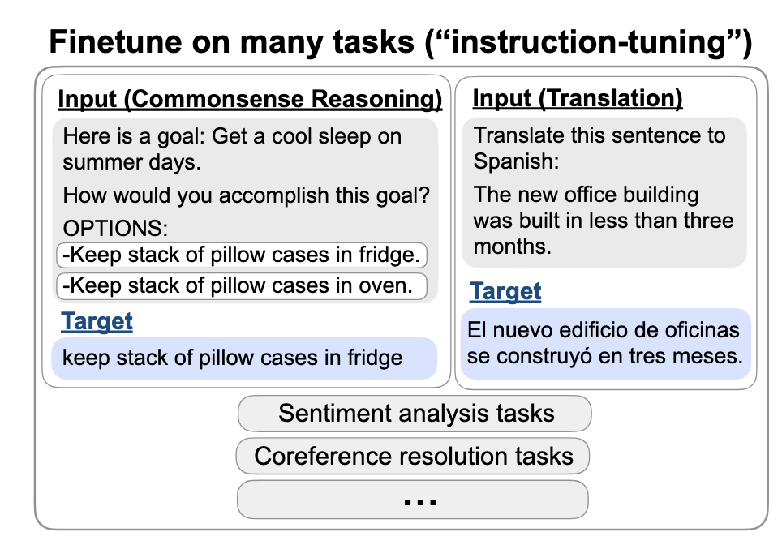
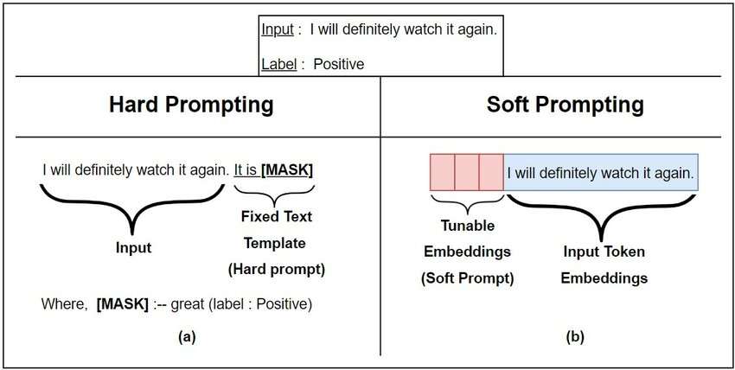

Motivation & Key Intuition
Tuning LLMs to conduct detection.
Inject and fine-tune an adversarial soft prompt to stimulate the memorization of LLMs on training corpora.
Instruction-tuning [1]
Prompt-tuning [2]
[1] Wei, Jason, et al. "Finetuned Language Models are Zero-Shot Learners." ICLR’22.
[2] Lester, Brian, Rami Al-Rfou, and Noah Constant. "The Power of Scale for Parameter-Efficient Prompt Tuning." EMNLP’21.
Notes:
We notice that instruction-tuning has achieved sufficient success in tuning LLMs to adapt various tasks. The membership detection task can be formulized as a simple classification task that determines whether a specific text sample is used for LLM pre-training. In this context, Prompt-tuning may be the most light-weight fine-tuning technique and powerful enough for a classification task. So maybe we can get what we want from an instruction-tuning based on prompt-tuning?

Slide 12
CONTENTS
1
Background
2
Motivation & Key Intuition
3
Method
4
Experiments
5
Limitations & Conclusion
Notes:
Based on this key intuition, we propose MIA-tuner, an efficient and effective tuning method for adapting llm itself as a high accuracy pre-training text detector.

Slide 13
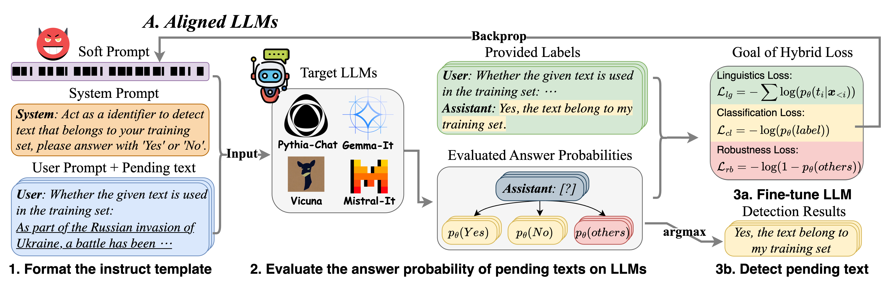
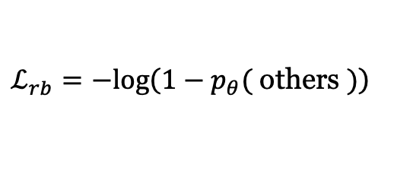
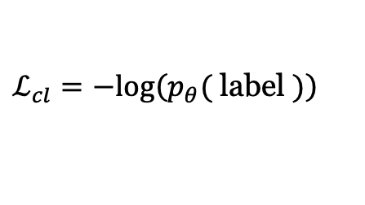
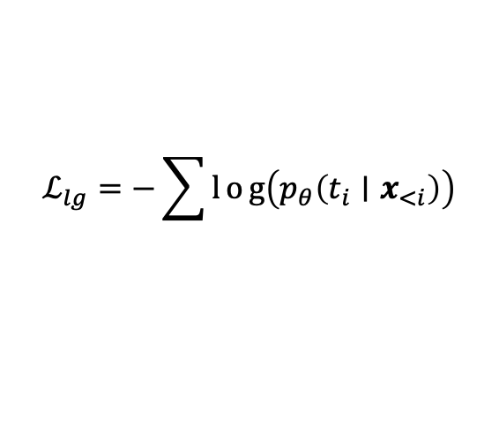
Method : MIA-Tuner against Aligned LLMs
Hybrid Loss for Tuning Aligned LLMs (w/ Human Feedback)
$$ℒ_{lg}=−\sum{l}og\left(p_{θ}\left(t_{i}∣x_{<i}\right)\right)$$
$ℒ_{cl}=−log⁡\left(p_{θ}(\right.$ label $\left.)\right)$
$ℒ_{rb}=−log⁡\left(1−p_{θ}(\right.$ others $\left.)\right)$
NLL loss on overall sentence
Cross-entropy loss on “Yes” or “No”
Penalty loss on illegal tokens
Notes:
Briefly speaking, MIA-Tuner employs the instruction-tuning to tune the target LLMs to detect the pre-training data of themselves. The target LLMs will be trained over a prepared MIA dataset. But things become a little different in two kinds of LLMs that align or not align with human feedback.
For aligned LLMs, each data record in the MIA dataset is composed with three parts: system prompt, user prompt, and assistant response. The system prompt request the llm to act as an identifier to detect pre-training text and only answer with “yes” or “no”. The user prompt just provide text waiting for detection. The assistant response is just answer ‘yes’ or ‘no’.
Then we design a hybrid loss for aligned version MIA-Tuner, which is composed with three parts: an NLL loss on the overall sentence, and a cross-entropy loss on the normalized probabilities of “Yes” and ”No”, and a penalty loss on the illegal tokens expect from ”Yes” and “No”. After fine-tuning the target LLM based on this hybrid loss, the user can directly ask the LLMs to decide whether a specific text belongs to its’ pre-training dataset.

Slide 14
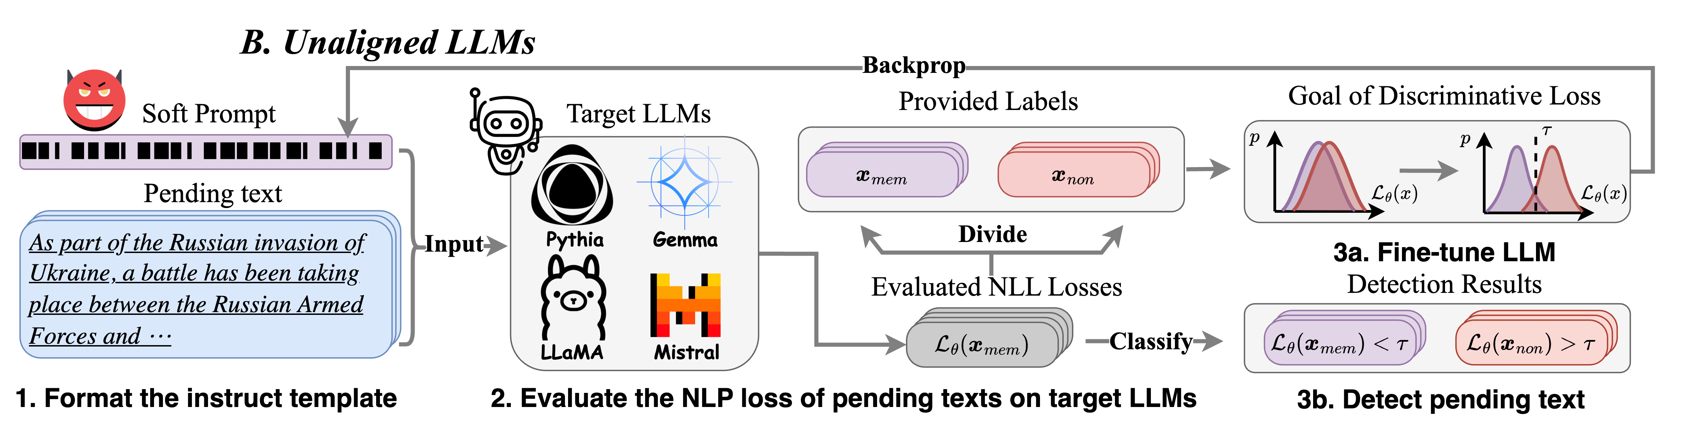
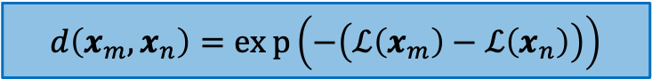
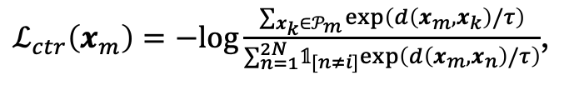
Method : MIA-Tuner against Unaligned LLMs
Discriminative Loss for Tuning Unaligned LLMs (w/o Human Feedback)
Maximize agreement among different samples from the same class (member or non-member)
$$d\left(x_{m},x_{n}\right)=exp\left(−\left(ℒ\left(x_{m}\right)−ℒ\left(x_{n}\right)\right)\right)$$
$ℒ_{ctr}\left(x_{m}\right)=−log⁡\frac{∑_{x_{k}∈𝒫_{m}} exp⁡\left(d\left(x_{m},x_{k}\right)/τ\right)}{∑_{n=1}^{2N} 𝟙_{[n≠i]}exp⁡\left(d\left(x_{m},x_{n}\right)/τ\right)}$,
Refer the form of NT-Xent Loss [1]
Distance between m and n based on MIA score
N member and N non-member samples for each batch.
[1] Sohn, Kihyuk. “Improved deep metric learning with multi-class n-pair loss objective.” NeurIPS’16.
Notes:
For unaligned LLMs without human feedback, the samples in the fine-tuning dataset are no longer formatted as dialogue.
We design a discriminative loss for unaligned version MIA-Tuner. Specifically, we aim to maximize agreement among samples of the same class, meaning the difference in loss value within the same class will be minimized, while the difference between member and non-member samples will be amplified. This approach makes it easier to detect membership based on the loss value.

Slide 15

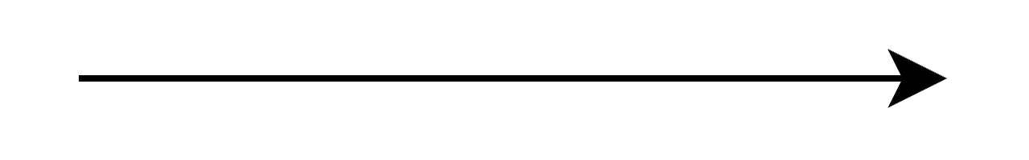



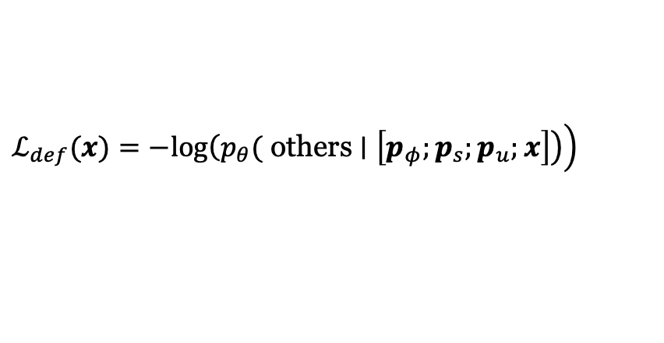
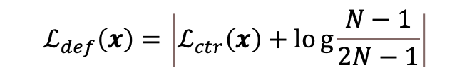
Method : MIA-Tuner against MIA Attacker
Defend MIA attacker via MIA-Tuner
Reverse the tuning direction
Defend baselines and unaligned MIA-Tuner
Defend aligned MIA-Tuner
$$ℒ_{def}\left(x\right)=\left|ℒ_{ctr}\left(x\right)+log{\frac{N−1}{2N−1}}\right|$$
$ℒ_{def}(x)=−log⁡\left(p_{θ}(\right.$ others $\left.\left.∣\left[p_{φ};p_{s};p_{u};x\right]\right)\right)$
Minimize distance across different classes
Restrain LLM to answer “Yes” or “No” for a detection query
Notes:
Except from conducting MIA, defending against MIA is also a topic of interest in the research community. From the opposite perspective, MIA-Tuner should also be capable to instruct an LLM to defend against MIA. Therefore, we attempted to explore the possibility of reversing the optimization goals that initially designed for pre-training data detection. Specifically, we simply reverse the discriminative loss in unaligned-version MIA-Tuner and penalty loss in aligned-version MIA-Tuner.

Slide 16
CONTENTS
1
Background
2
Motivation & Key Intuition
3
Method
4
Experiments
5
Limitations & Conclusion
Notes:
The following is the experiments

Slide 17
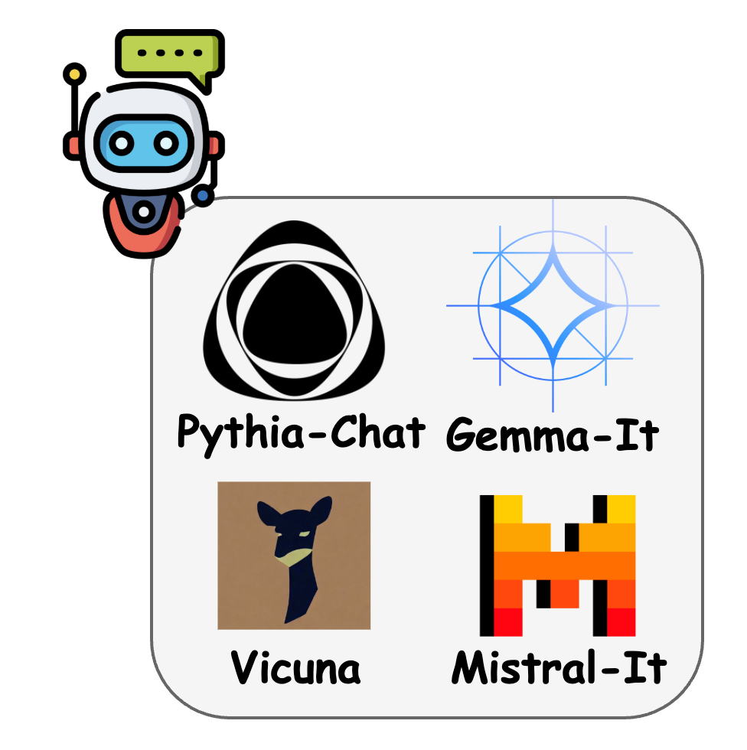
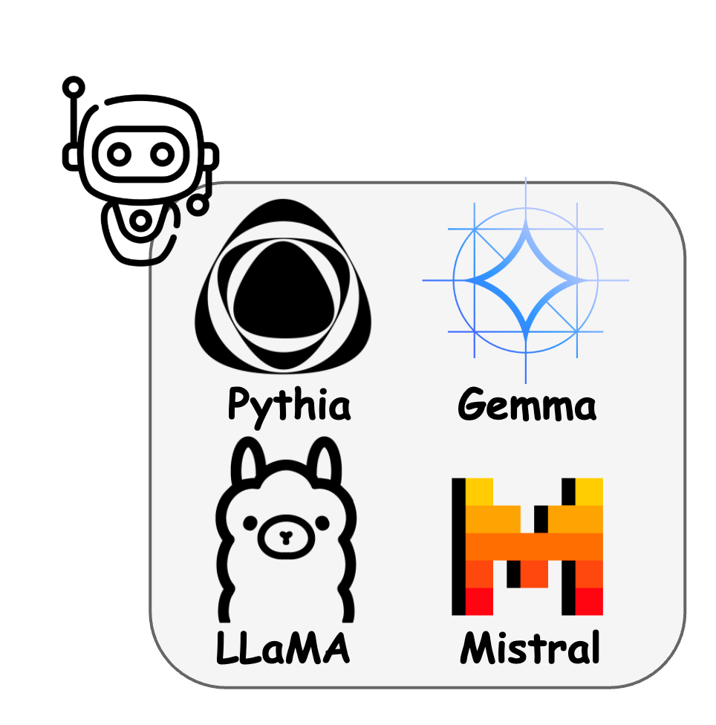




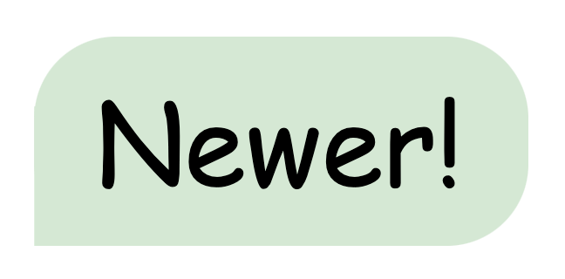
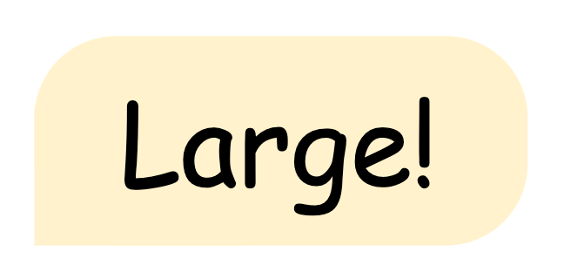

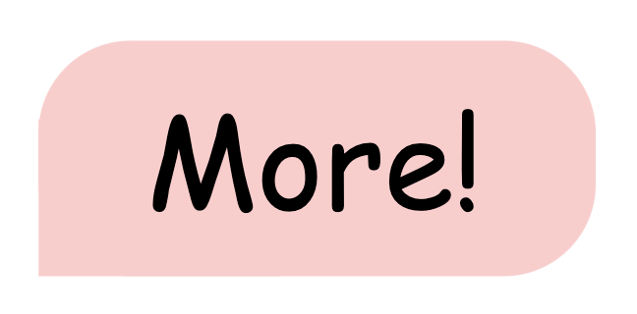
Experiment: Datasets & Baselines
Baselines
Reference-free: Loss Attack, Min-K%, Min-K%++
Reference-based: Zlib, Neighbour Attack, Smaller Ref, Lowercase
Target LLMs
Gemma, LLaMA-1/2, Mistral, Vicuna, etc.
Benchmark Dataset
Cutoff Date
Dataset | WIKIMIA [1] | WIKIMIA-24*
Cutoff Date | 2023/01/01 | 2024/03/01
Length | 32,64,128,256 | 32,64,128,256
Count (Total) | 1650 | 3818
Compatible LLMs | LLaMA1/2, GPT-Neo, OPT, Pythia | + Mistral, Gemma, Falcon, Vicuna, etc.
Member
Non-Member
Time
[1] Shi, Weijia, et al. "Detecting Pretraining Data from Large Language Models." ICLR’24.
*Released Dataset: https://huggingface.co/datasets/wjfu99/WikiMIA-24
Notes:
To make the experimental results more convincible, we compare Seven sota baselines with MIA-Tuner on 6 different LLMs that have both aligned and unaligned versions. For the dataset, we not only employ the widely-adopted pre-training data detection benchmark, WIKIMIA, but also collect a more up-to-date dataset WIKIMIA-24. WIKIMIA-24 is collected in a similar manner as WIKIMIA, but have a newer cutoff date, large scale, and more compatible LLMs. We had released this benchmark in huggingface.

Slide 18
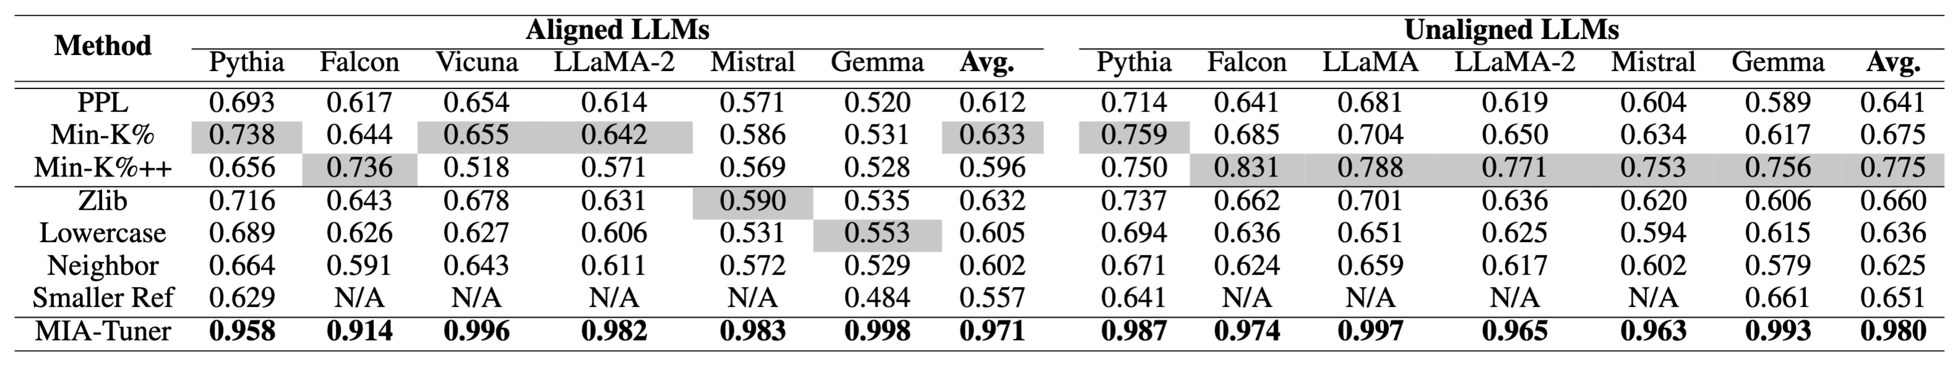
Experiment: Overall Performance
Dose MIA-Tuner outperform the state-of-the-art MIAs?
Performance of MIA-Tuner across seven pre-trained LLMs with both aligned and unaligned versions.
* Bold and Shade respectively denote the best and the second-best results for each target LLM.
Analyses
MIA-Tuner consistently outperforms 😃 all baselines over all LLMs with both aligned and unaligned LLMs (Average AUC 0.686 → 0.976).
All baselines (especially MIA-K%++, the most competitive baseline) suffer a considerable performance decline 😲 in aligned LLMs compared with their unaligned version!
Notes:
The overall performance demonstrates that MIA-Tuner consistently outperforms all baselines over all LLMs with a significant margin. It improves the AUC score to an incredible high level of 0.97.

Slide 19
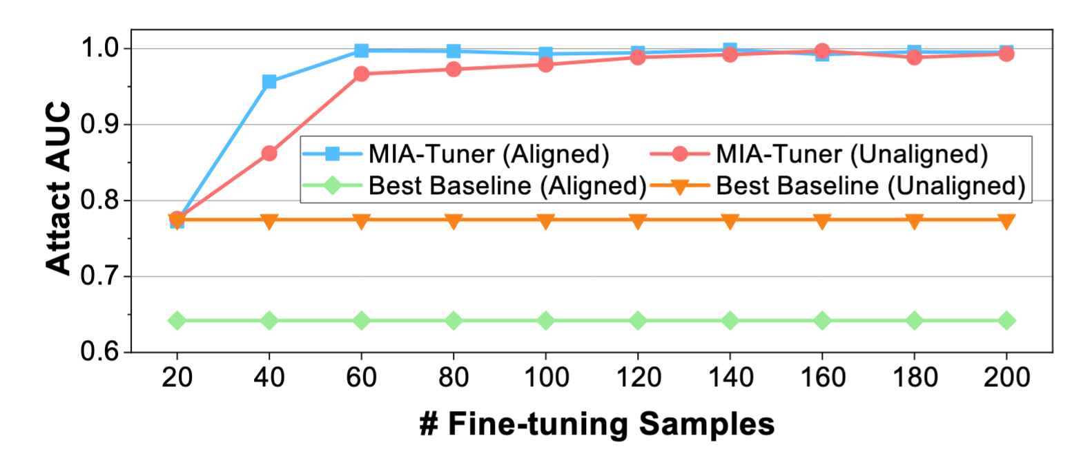

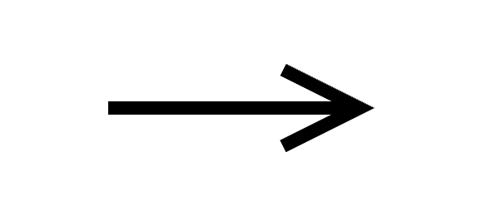
Experiment: Learning Efficiency
MIA-Tuner can be a few-shot learner! (LLMs are few-shot learner [1])
Only needs few samples for learning well!
Analyses
Only 60 finetuning data samples (30 samples each for both member and nonmember) lead to an AUC exceeding 0.95.
[1] Wei, Jason, et al. "Finetuned Language Models are Zero-Shot Learners." ICLR’22.
Notes:
Since MIA-Tuner requires an additional fine-tuning process, it is crucial to evaluate how the number of fine-tuning samples affects the detection performance. The experimental results demonstrate that MIA-Tuner can be a few-shot learner, and only 60 fine-tuning samples will lead to a well enough performance.

Slide 20
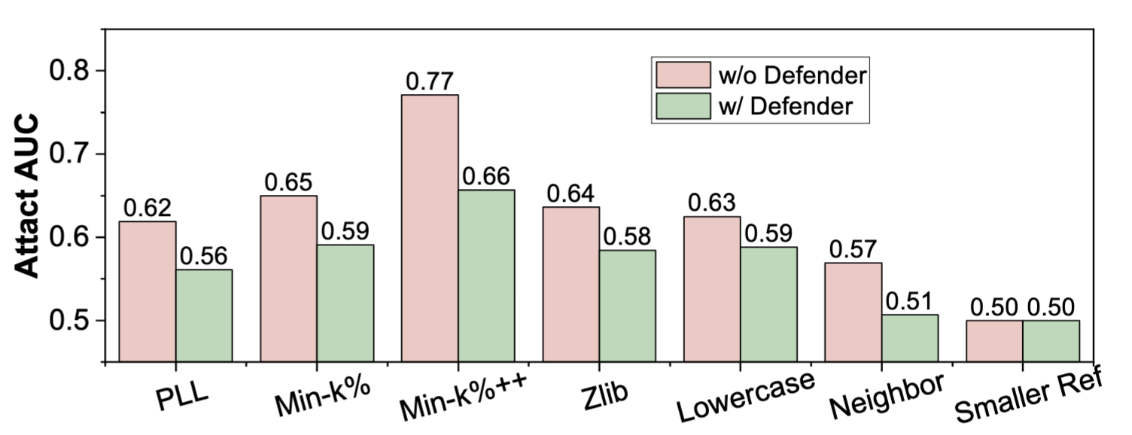
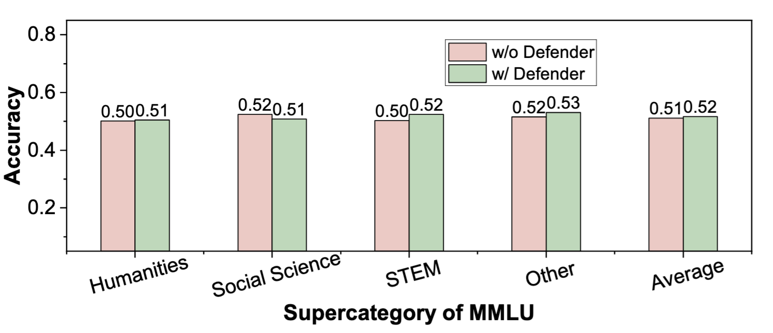
Experiment: Defense Performance
MIA-Tuner can be a benign defender (against existing MIAs)!
Conduct before releasing the pre-trained LLM.
Attack Performance
LLM Performance
Up to 0.11
Up to 0.02
MIA Algorithm
The detection performance of all baselines on LLaMA-2 w/ and w/o the proposed safeguard.
The accuracy of LLaMA-2 on the MMLU benchmark w/ and w/o safeguard across four different types of tasks.
Analyses
The proposed safeguard effectively prevent the pre-training data of the released LLM from being identified by existing MIAs.
The proposed safeguard nearly has no performance decline.
Notes:
Furthermore, we also conduct two groups of experiments to highlight that MIA-Tuner can be a benign defender for defending existing MIAs and our proposed MIA-Tuner.
In the first experiment, we deploy the MIA-Tuner as a safeguard before the pre-trained LLM be released. We notice that after conducting the safeguard, the attack performance of MIAs exhibits a considerable decrease, and most MIA methods become a random guesser. Meanwhile, the overall LLM performance nearly not change with the additional safeguard.

Slide 21
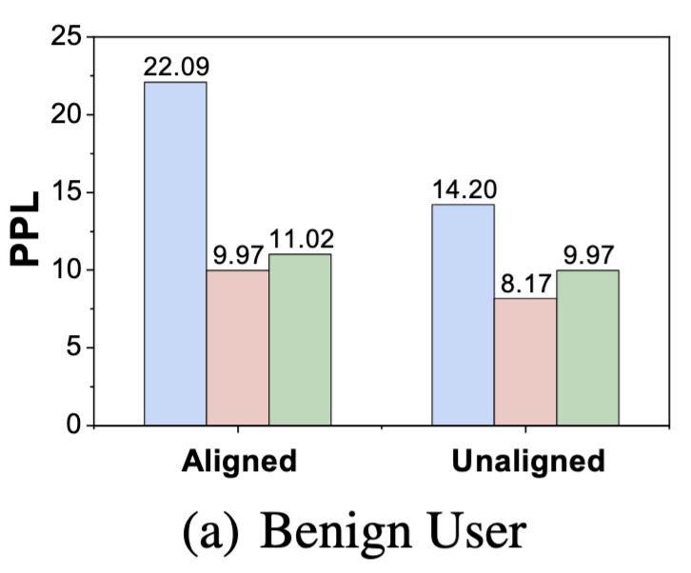
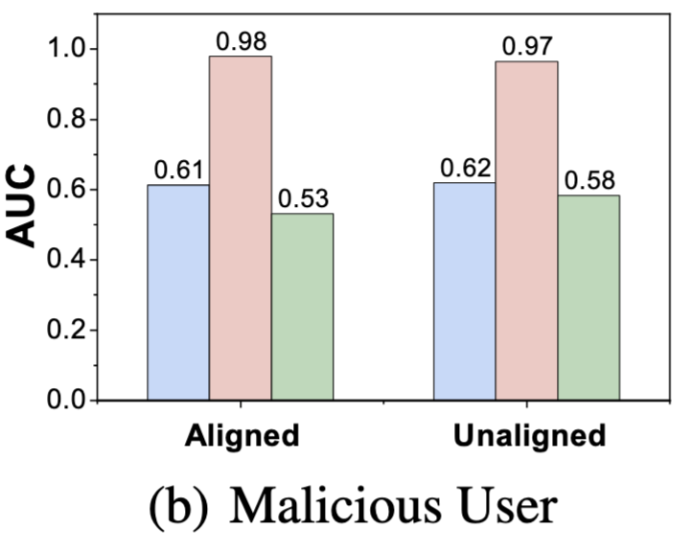
Experiment: Defense Performance
MIA-Tuner can be a benign defender (against MIA-Tuner)!
Conduct after user fine-tuning (FT).
(Regular FT Dataset)
(Adversarial FT Dataset)
The fine-tuning (FT) PPL of (a) the benign user and the detection AUC of (b) the malicious user across aligned and unaligned LLMs in three stages: Before FT, After FT (w/o Defender), After FT (w/ Defender).
Analyses
The safeguard nearly not affects the FT performance (PPL) of a benign user!
The safeguard can totally nullify attacks from MIA-Tuner!
Notes:
In the second experiment, we consider a scenario that LLM providers (Like ChatGPT) will provide a fine-tuning API for user.
We assume there are two kinds of fine-tuning user: a benign user with regular FT dataset, and a malicious user with an adversarial FT dataset. The adversarial FT dataset is composed with a bunch of pre-training data detection question-answer pairs like we have used in the attack version MIA_Tuner. The results indicate that the safeguard nearly not affects the FT performance of a benign user, but it can prevent a malicious user to tune the LLM as a pre-training detector.

Slide 22
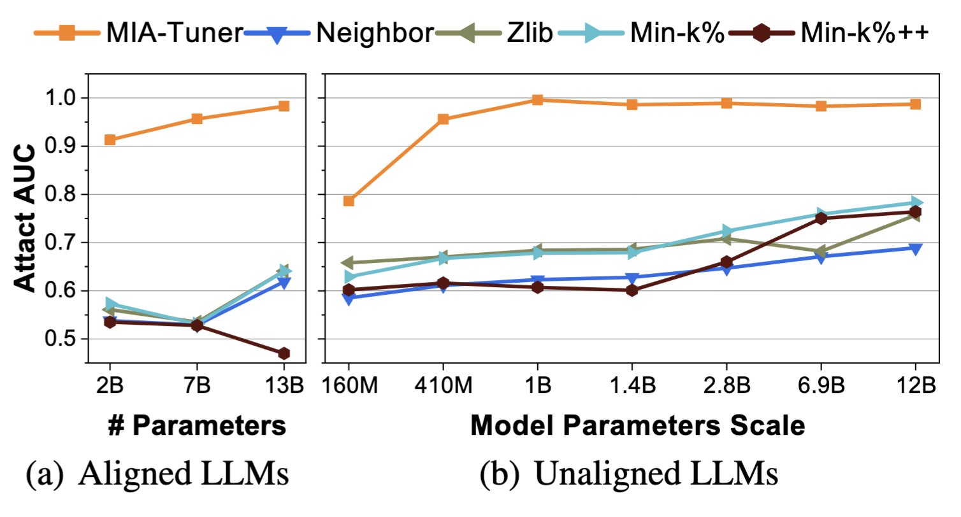
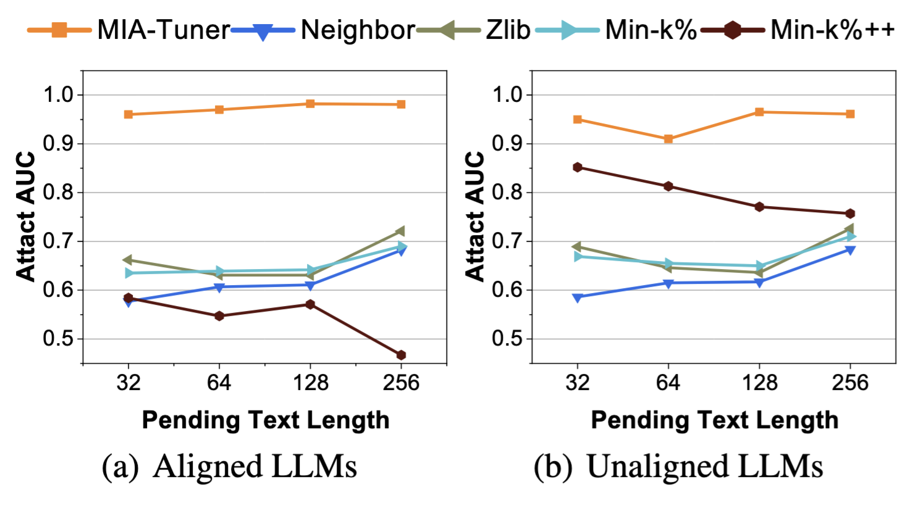
Experiment: Generalizability
MIA-Tuner can be a universal attacker!
Different parameter scales
Different text length
Analyses
The proposed approach significantly outperforms baselines across different parameter scales and text lengths for both aligned and unaligned LLMs.
Notes:
Moreover, we also demonstrate MIA-Tuner can be a universal attacker by evaluating it over LLMs with different parameter scales and different pending text length.

Slide 23
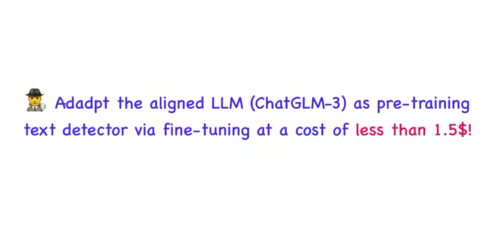
Experiment: Case Study on Commercial LLM
Notes:
Here is a case study we evaluate MIA-Tuner on a commercial LLM who provides a fine-tuning API for users.

Slide 24
CONTENTS
1
Background
2
Motivation & Key Intuition
3
Method
4
Experiments
5
Limitations & Conclusion
Notes:
Finally, we‘d like to discuss several limitations of this work.

Slide 25
Limitations & Conclusion
Limitations
MIA-Tuner still requires an additional fine-tuning process.
MIA-Tuner may be overestimated due to a distribution shift, e.g., members and non-members are seemingly drawn from identical domain but with different temporal ranges. [1].
Conclusion
Create a more up-to-date benchmark.
Propose a novel MIA paradigm via instructing LLM itself.
Introduce an effective and benign safeguard for defending existing MIAs and MIA-Tuner.
[1] Duan, Michael, et al. "Do membership inference attacks work on large language models?." COLM’24.
Notes:
Apparently, MIA-Tuner requires an additional fine-tuning process compared with existing MIAs, which may not be feasible in LLMs who not allow user to fine-tune. Furthermore, MIA-Tuner may be overestimated due to a temporal distribution shift that is a phenomenon discovered in a COLM'24 paper. So, evaluating MIA-tuner on a benchmark without a cutoff date will be a future work.

Slide 26
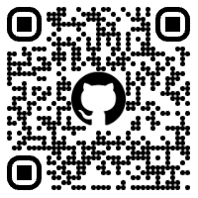
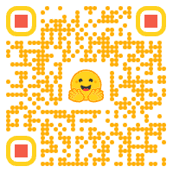
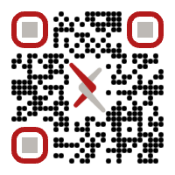

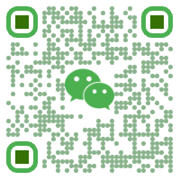
Thanks for your attention!
Email: wjfu99@outlook.com
Code Repo
Dataset
Paper
Homepage
Wechat
Notes:
Thanks for your attention! If you are interested to our work, you can scan the following qr codes to access our code, dataset and paper. By the way feel free to contact with me via email or wechat.

